Slide 1

Database Forensics
How Data Solves Crimes in Large Organisations
A 7-slide guide to investigating data
at scale with SQL and audit logs
EVODIA UNJUEH AKU
unjuehevo@gmail.com
Day 2 of 30 | June 2026

Slide 2
DATABASE FORENSICS = DIGITAL EVIDENCE
APPLICATION EXERCISES
QUESTIONS:
When an HR or DBA uses their access to DROP tables, OVERWRITE codes and ALTER schemas to hide fraud. What footprints are physically impossible to erase?
If a ghost worker looks 100% clean inside payrolls, how do you prove that they don’t exist in the real world using multi-layered data analytics?
Which method is most effective MANUAL or DATABASE FORENSICS?
SQL + Audit Logs + Timestamps = The Truth

Slide 3
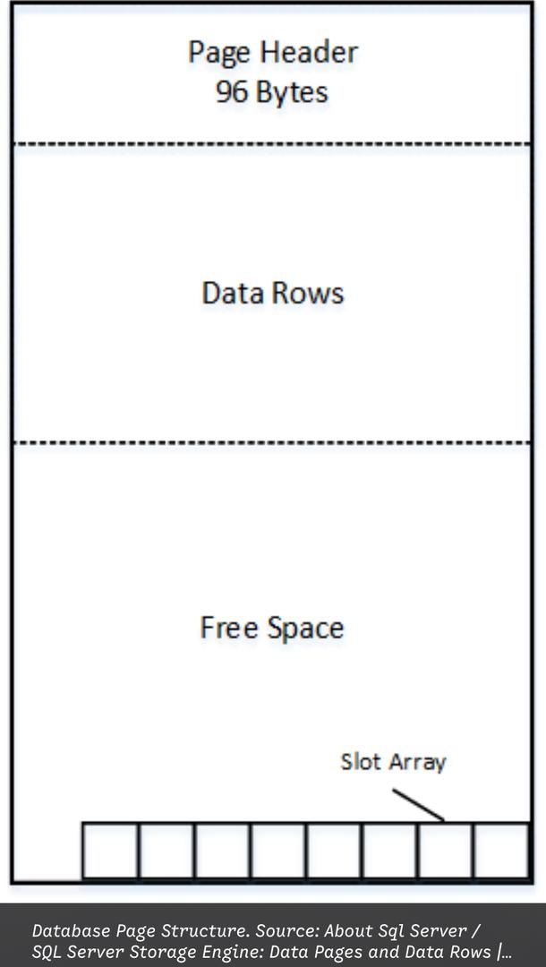
THE ANATOMY OF DATABASE PAGE (WHY DATA LINGERS)
Database doesn’t write data randomly; they store it in structured blocks called pages.
PAGE HEADER
(System notes: Page ID, space left, etc.)
DATA ROWS
[Row 1: Admin logged In]
[Row 2: Fraudulent paycheque sent to account x ] What the suspect wants gone
[Row 3: System Normal]
FREE SPACE
(Empty room waiting for new data)
SLOT ARRAY
[Pointer 1: -> Row 1]
[Pointer 2: -> Row 2] X (change to “empty space”) The shortcut
[Pointer 3: -> Row 3]

Slide 4
HERE,
WAL( Write-Ahead Logging)
TRANSACTION LOG
Timestamp: 10:14:02 AM
User Account: HR_Officer_01
Action: Executed DELETE command on Table ‘Payroll’ for Row ID 942
Active Directory (AD) Check
The physical Access test(badge swipes or biometric logs)
SQL Banking Interrogation ( The Cash Routing Trick)
FORENSIC TAKEWAY: Unless a drive is physically shredded or magnetically wiped, remnant survive. Between raw data carving from unnallocated space and reconstruction history via Write-Ahead Logs( WAL) , an investigator can almost always rebuild the timeline and find the missing file.
True verification happens at the intersection of disconnected silos.
Structural destruction does not equal data destruction; even sophisticated data manipulation cannot erase a digital footprint.
While the structural pointers are gone, the raw data pages often remain intact in the database files until maintenance routines or page allocations reuse that space.

Slide 5
SOLUTIONS
QUESTION ONE: THE ROGUE ADMINISTRATOR
CHECK what is still in the DB
Soft delete (delete_at = now() the row is still there.
Hidden in history table: look for audit/ history tables.(employee_history, audit_log, pg_log, sys.audit.)
Indexes: sometimes the index entry stays longer than the row.
Use transaction logs,
Postgres: WAL files in pg_wal/. Tool like pg_waldump can read them.
MYSQL/MariaDB: Binlogs and redo logs. mysqlbinlog lets you see INSERT/DELETE statements.
SQL Server: Transaction log LDF files. Tools like fn_dblog can read them.
Oracle: Redo logs and archive logs.
Check backups and snapshots(most companies have daily backups, snapshots, or point - in - time recovery.
File System level recovery( if the actual database file was deleted from disk :
DON’T write on the disk. Stop the DB and unmount the volume.
Use file carving tools: scalpel, foremost, autopsy to recover deleted.dbf, .mdf, .ibd files.
Look at file system metadata: MFT in NTFS, inode in ext4. it tell you when the file was deleted.
Memory and page files(running database keep data in RAM and buffer pools.

Slide 6
FORENSIC RECOVERY TECHNIQUES
Log Analysis
File Carving
Page Scraping
Git History Carving
(memory caches, temp directories, or unallocated space on the web/application server
The Timestamped Discrepancy
Hex Editor and Disk Imaging Tools
Encase/FTK Imager
010 Editor/ WinHex
ApexSQL Recover/ Quest Software
SysTools SQL Recovery
FQLite/ Undark
SQL Banking Interrogation

Slide 7
QUESTION 2: THE GHOST WORKER DETECTION
Check login and activity logs(IDs, IP addresses, timestamps(payroll records but 0 activity
Check Audit Trails(created,modified,odd hours)
Check payroll Payouts(match employee ID to bank account
RED FLAG = multiple employee Same account, or account doen’t match HR data
Payroll DB vs HR DB vs LDAP vs Email server vs Banking payout file.
“Impossible “ state: 2 people with same SSN, 1 bank account for 1 employees, salary paid but no tax deduction.
Look at backups and snapshots. attackers rarely delete all of them.
Manual checks catch obvious fraud. Cross-layer forensics catches hidden fraud.
Database Forensics is how an organization protects its entire structural intergrity.
Can we prove every paid employee exists in HR and IT systems?
Who has DBA access, and are their actions logged outside the DB?
Do we test our backups by restorng them?
EXPLORE THE FULL REPO ON GITHUB.

